Slide 1

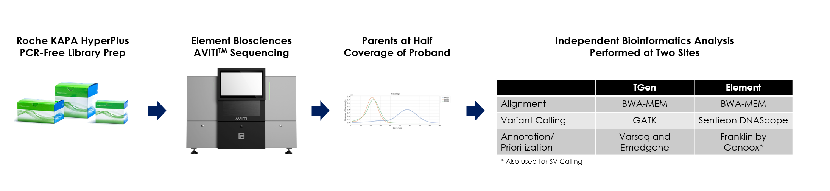
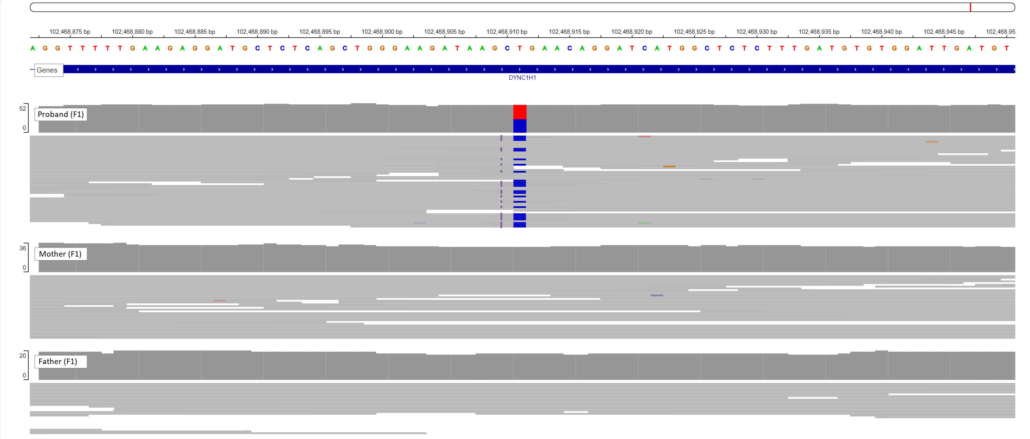
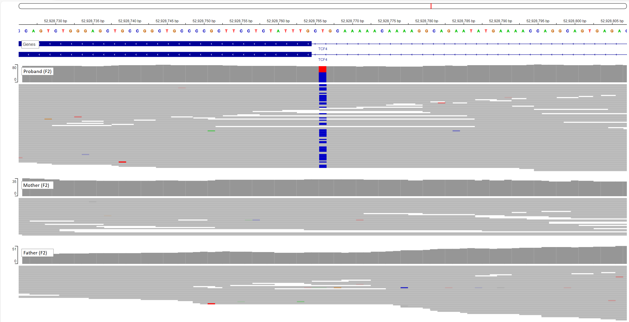
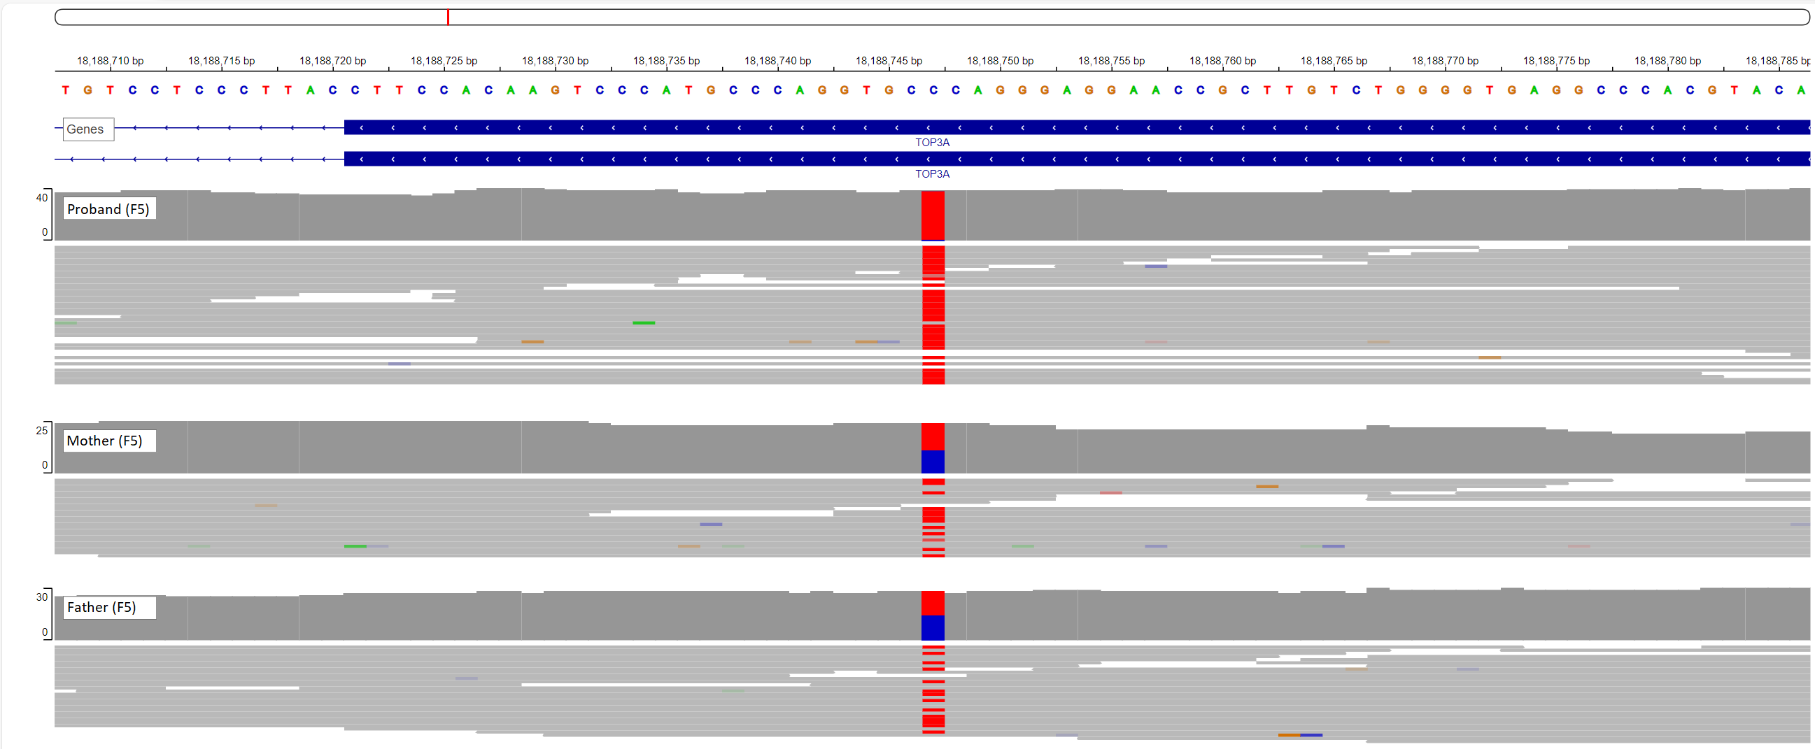
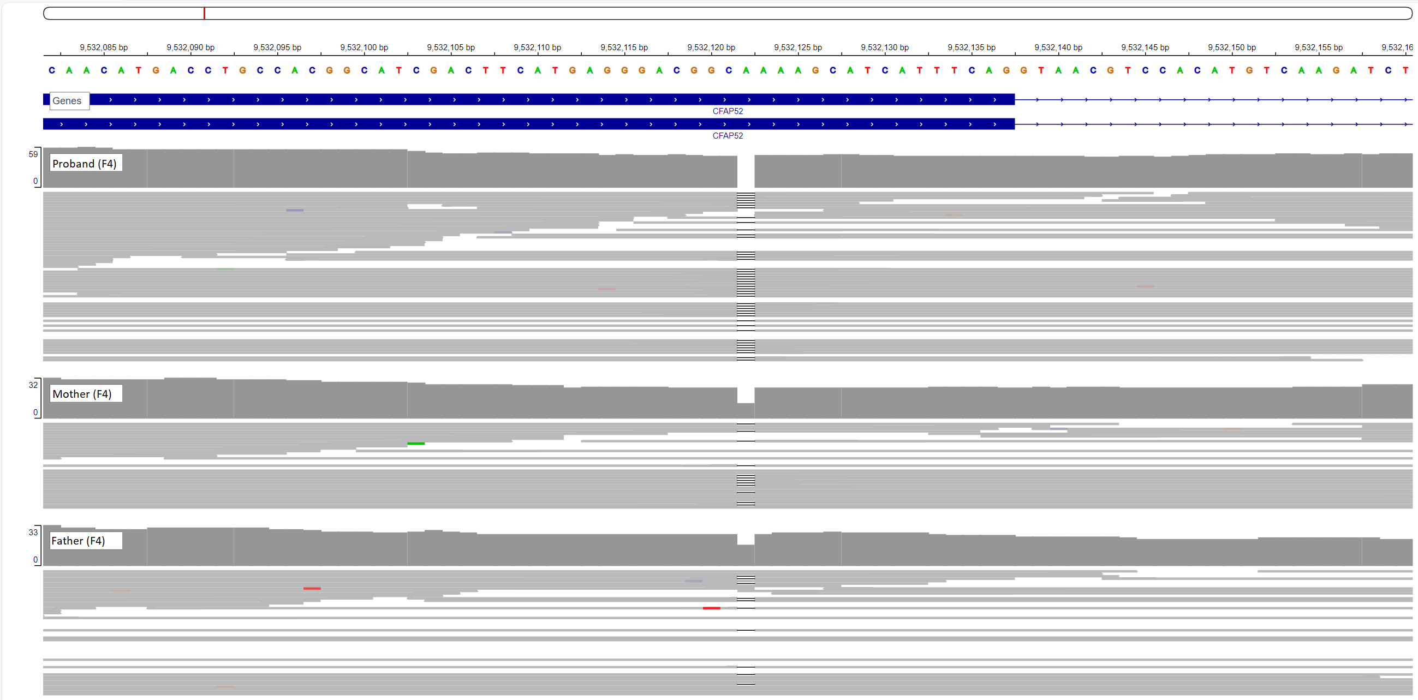
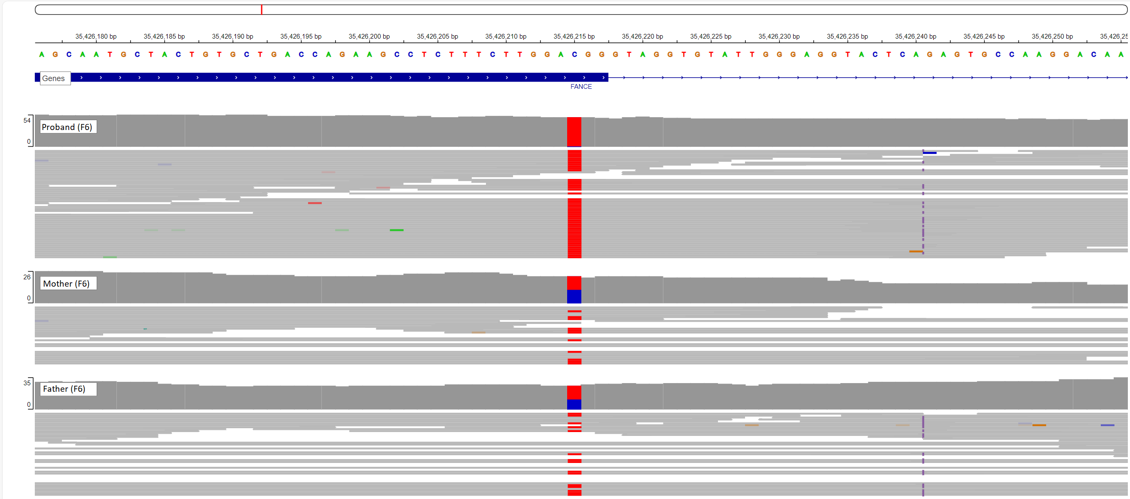
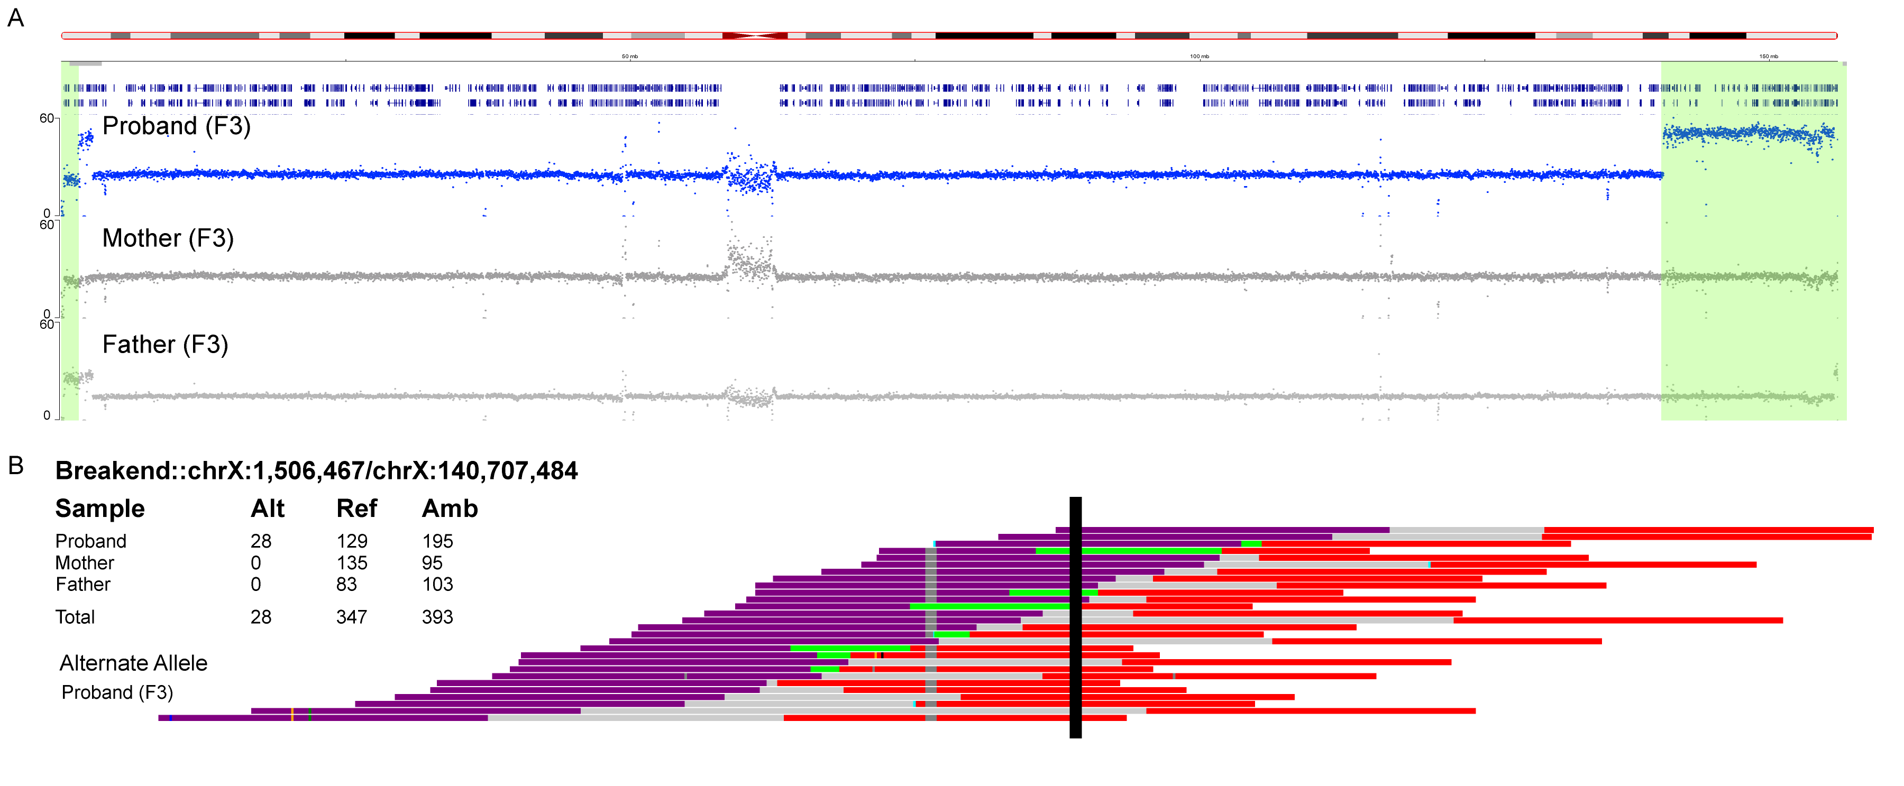



Trio sequencing with parents at half coverage solved 6 of 9 rare disorder cases, with 3 having de novo variants as causal
An efficient design for whole genome trio sequencing identifies causal variants in rare neurological disorder cases
Background
Methods
In this study, we sequenced nine trios consisting of a proband affected by a rare, undiagnosed neurological disorder and both parents to enable identification of de novo variants, which are often the cause of genetic neurological disorders. We chose to sequence the proband at a typical coverage level of approximately 35-40X and the parents at half that coverage (~15-20X). The design is efficient in cost and time because the three genomes can be sequenced in a single flowcell of the AVITI benchtop sequencing instrument. We hypothesized that we would be able to observe inheritance patterns and identify de novo variants even with the reduced coverage in the parents. All findings were validated via clinical sequencing or arrays.
Results
De novo frameshift indel in DYNC1H1
De novo splice-affecting variant in TCF4
Homozygous missense variant in TOP3A. Both parents are carriers of the same rare variant
Homozygous frameshift in CFAP52. Both parents are carriers of the same rare variant
Homozygous missense variant FANCE. Both parents are carriers of the same rare variant
ID | Gene | Variant | Inheritance | Patient Phenotypes | OMIM Disorders | TGen Recommendations | CADD* | gnomAD Allele Frequency | ClinVar | Previous Literature
1 | DYNC1H1 | c.4580delinsCC, p.L1527Pfs*9 | Het de novo | Global developmental delay, ID, Seizures, Cerebral hemorrhage | Autosomal dominant Charcot-Marie-Tooth disease type 2O (CMT2O) (614228); Autosomal dominant spinal muscular atrophy with lower extremity predominance (158600); Complex cortical dysplasia with other brain malformations-13 (CDCBM13)(614563) | Referred family to support group, research, discussed recurrence risk | 25 | - | - | -
2 | TCF4 | c.923-2 A>G, splice acceptor variant | Het de novo | Global developmental delay, Nonverbal, Hypotonia, Short stature, Happy demeanor | Pitt-Hopkins syndrome (PHS) (610954) | Referred family to the support group and registry at the Pitt Hopkins Research Foundation, gene therapy and therapeutic drug research, discussed recurrence risk | 35 | - | Pathogenic (656789) | PMID: 19235238, 31440721
3 | chrX terminal del/dup | Terminal deletion 1.45 Mb Xp22.33 and terminal duplication 15.1 Mb Xq27.1 to Xq28 | Het de novo | Developmental delay, Microcephaly, Hypotonia, Hypoplasia of corpus callosum, High pain tolerance, Seizures, Hypothyroidism, Facial dysmorphism, Cryptorchidism and Micropenis | ChrX del: Includes 10 genes (1458 kb), SHOX (SHOX deficiency disorders: 249700, 127300, 300582) and CSF2RA (Pulmonary surfactant metabolism dysfunction-4 (SMDP4):300770); ChrX dup: Includes 130 genes (15143 kb), MECP2 (MECP2 Duplication syndrome: 300260) | Provided resources from Unique, recommendations of FISH studies in at least mother but also proband's siblings to determine if mother has a pericentric inversion | - | - | - | PMID: 26236399, 15309625, 3474636
4 | CFAP52 | c.1162del p.S388Afs*21 | Hom recessive | Global developmental delay, Hearing impairment, Dextrocardia, Transposition of the great arteries, Situs inversus totalis | Visceral heterotaxy-10 (HTX10)(619607) | Recommendations for creating social media support group, family planning | 33 | 0.00007074 | - | -
4 | PALB2 | c.2257 C>T, p.R753* | Het maternal | Incidental Finding: Risk for Hereditary Breast and Ovarian Cancer (HBOC) | Hereditary Breast and Ovarian Cancer (620442); Fanconi anemia of complementation group N (610832) | Counseled mother about risk for HBOC, recommendations for increased screening, risk reducing surgery, testing of family members; mother does not meet NCCN criteria for testing based on personal and family hx | 33 | 0.00002386 | Pathogenic (142403) | PMID: 19264984, 19763884, 21618343, 25186627, 27276934, 28281021, 27783279
5 | TOP3A | c.1685 G>A, p.G562E | Hom recessive | Global developmental delay, Microcephaly, Short stature, Decreased body weight, Periventricular leukomalacia, Delayed gross motor development | Microcephaly, growth restriction, and increased sister chromatid exchange 2 (618097) | Recommended sister chromatid exchange studies, follow-up ECHO, discussion of "mitochondrial cocktail" with her healthcare team, discussed recurrence risk | 28 | 0.00002388 | - | -
6 | FANCE | c.1111 C>T, p.R371W | Hom recessive | Thrombocytopenia, VSD, Single kidney, Unilateral deafness, R Thumb abnormality, Short stature, Triangular face, Narrow nasal bridge, Learning delays | Fanconi anemia complementation group E (600901) | Referral to the Fanconi Anemia Research Fund and Family Support Group, discussion of hematopoietic cell transplant, cancer surveillance, family planning | 32 | 0.0001167 | Pathogenic (566449) | PMID: 17924555, 22778927, 33942288
*CADD = Combined Annotation Dependent Depletion
Conclusions
Proband sequenced at ~35-40X and parents sequenced at ~15-20X
Design enables de novo and complex variant detection
Three genomes sequenced on a single flowcell
Six out of nine individuals diagnosed following clinical confirmation of all variant calls
Results led to counseling on family planning, as well as screening and treatment recommendations
(A) Coverage of ChrX showing de novo deletion in the PAR1 region and a de novo duplication near the end of the chromosome in the proband. (B) SVVIZ display showing the junction between the early part of the chromosome and the duplication.
S. Kruglyak¹, K. Ramsey², M. Naymik², B. R. Lajoie¹, K. N. Blease¹, M. Sanchez-Castillo², S. Billings¹, W. Jepsen², M. Huentelman², V. Narayanan²
¹Element Biosciences, San Diego, CA, ²TGen, Phoenix, AZ

